Slide 1
Via.com
By - Group 4

Slide 2

INTRODUCTION
Via, formerly Flight Raja, is a travel services company. Via is the largest travel network in India, spread across over 1,700 cities.
Via.com provides a travel-focused e-commerce platform with an emphasis on Asia.
Our objective was to automate various functions of via.com web application using Selenium and Java.

Slide 3
GROUP MEMBERS
Arunava Das
Mohammad Faisal (TL)
Priyanka Patil
Shakeeb Ansari
Souvik Chakravarty
Vaibhav Raj Pandey
Vaibhavi Gunjal

Slide 4
FEATURES TO BE TESTED
Registration
Login
Flights
Hotels

Slide 5
FRAMEWORK & TECHNICAL ASPECTS
Object Repository
Page Object Model (POM)
Excel
TestNG Data Provider
Allure Reports

Slide 6
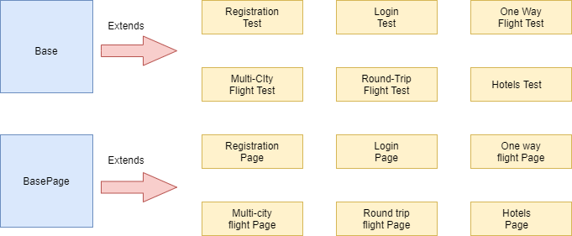
ARCHITECTURE

Slide 7
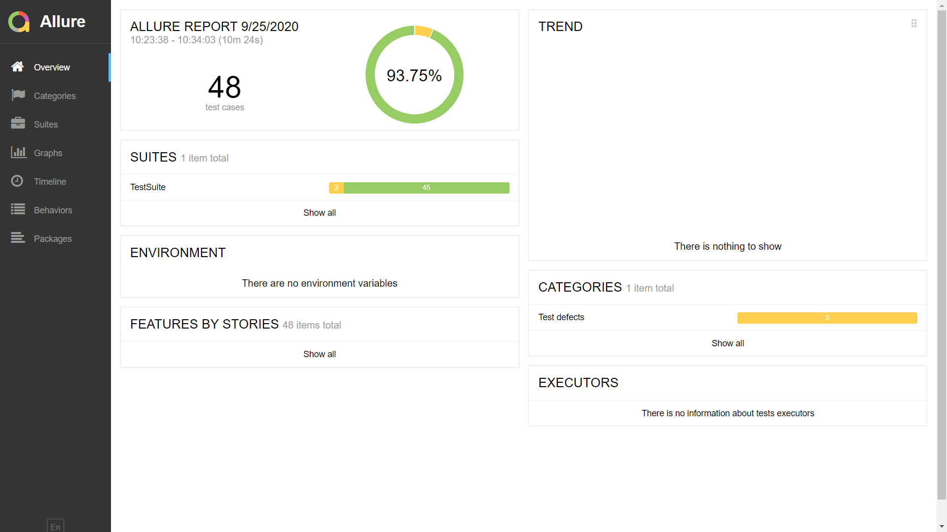
Snapshots
Below is the snapshot of allure test report

Slide 8
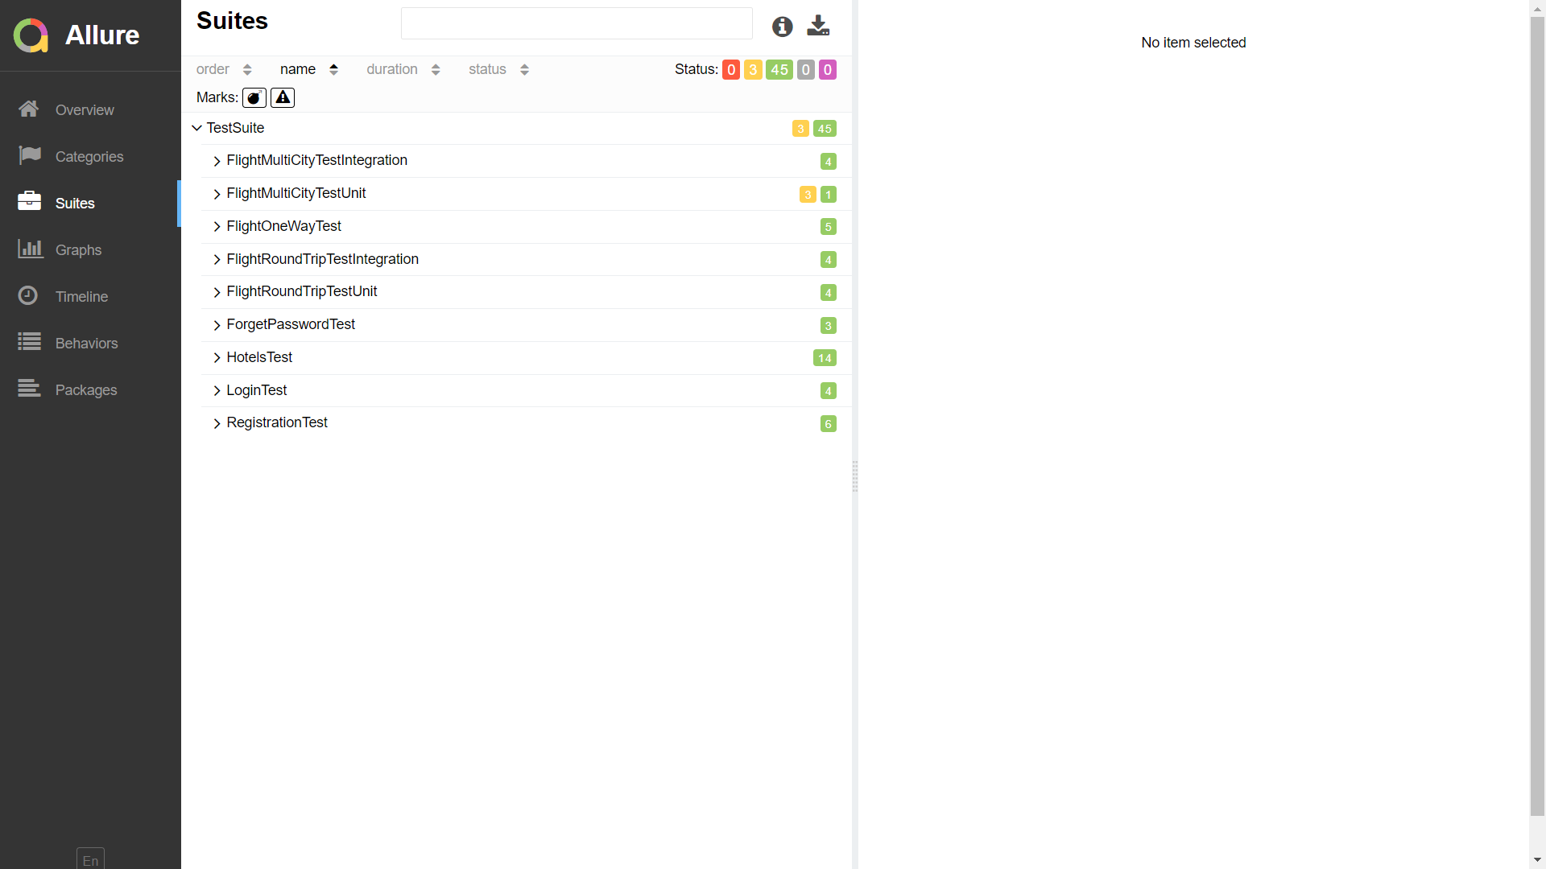
Snapshots
Below is the snapshot of individual test status

Slide 9
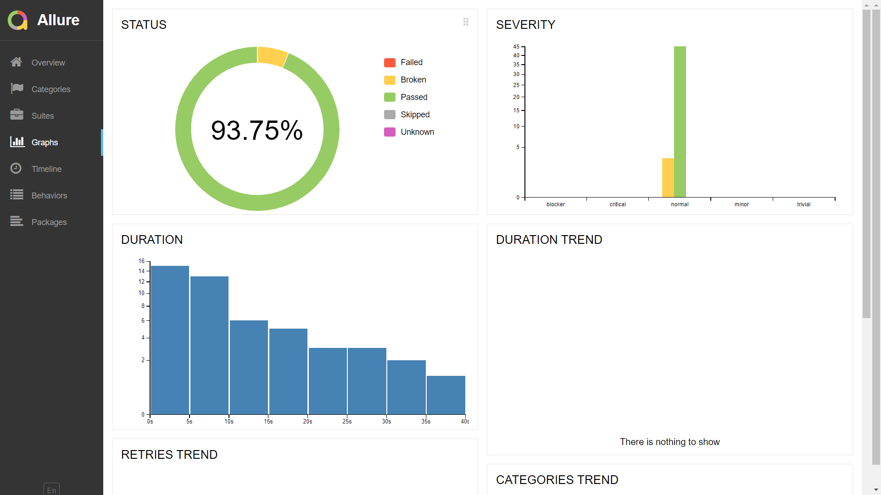
Snapshots
Below is the snapshot of final report status with graphs

Slide 10
TEST CASE SUMMARY REPORT
No.of Modules | Total Test Cases | Total Cases Automated | Test Cases Passed | No. of Defects Identified
5 | 48 | 48 | 45 | 3

Slide 11
CHALLENGES FACED
Retrieving data from excel sheets.
Dynamic error message handling.
Dynamic elements loading time.
Calendar issues.
Handling cookies.

Slide 12
DEFECTS FOUND
No Email/Mobile verification after creating new account.
OTP takes some time to deliver in forgot functionality
Doesn’t display error message for second entry field if first entry field is invalid
Select options for Passport details not displayed under hotel booking
Values under child age drop down option
DOB of infants greater than 2 years of age is accepted
Flight search page takes a while to load
Calculation of final amount takes a while sometimes
Room search page takes a while to load

Slide 13
LESSONS LEARNT
Team work.
Hands on training on selenium.
Framework model advantages.
Working with allure report.
Time management & meeting deadlines.

Slide 14
THANK-YOU!

